Slide 1
MSc AI for marketing strategy
Customer Relationship Management course
Session #1
Robert Fonteijn

Slide 2













Robert Fonteijn
A three-legged stool: consulting, business school teaching and volunteer work. I support my clients in gaining competitiveness in a VUCA world, my students in engaging with the 21st rather than the 20th century, and all parties I work with in making an impact on things that matter.
CleverValues

Slide 3

Agenda for this S1
Why ?
What ?
How ?
A few initial thoughts and exercices
Work for next time

Slide 4
Individual activity
Why are we / you interested in CRM ?

Slide 5
A bit of context : the 2020s are a period of transitions
In the business world generally.
In terms of organisation models.
In terms of managerial activities.
What is currenty going on ?

Slide 6
Business transitions
Supply (first, produce it) | Demand (sell it first)
Outbound | Inbound
Shareholders | Stakeholders
A straight line: linear, evolution Exclusively focused on the issue of economic growth | Disruption, VUCA Focused on the idea of balance between economics, social and ecological.

Slide 7
Organisation models
Constraint | Free agency
Hierarchy | Democracy / equality
Limited feedom of action | Freedom of action
Centralisation : large unified corporation Initial education covers a full professional life | Decentralisation : intra- or entrepreneurial models « Lifelong learning » a half-life of knowledge of 5 years

Slide 8
Managerial activity
Task | Relationships
Principles | Applications
Extrinsic motivation Simple questions / problems * | Intrinsic motivation Complex problems
« Tell ‘em » = instruct people what to do and how to do it. | People are professional experts. They know better than their managers how to do their work. A manager is just « passing through ».

Slide 9
Simple vs complex questions, issues & problems
Business is characerised by complexity rather than simplicity.
Simple questions / issues / problems:
Are well-defined.
Have a limited number of possible solutions...
… which can be found by logic or experience (often by copy/pasting what has worked in the past).
Complex problems can only be solved by lateral and innovative approches, looking at things systemically.

Slide 10
More context : some tech trends
Silicon Age |  | Engineering tomorrow
Advanced connectivity Applied AI Cloud and Edge computing Immersive-reality technologies Industrialising machine learning | Next generation software development Quantum technologies Trust architectures and digital identity Web3 | Future of bioengineering Future of clean energy Future of mobility Future of space technologies Future of sustainable consumption
Source: McKinsey Technology Trends Outlook 2022

Slide 11
And finally, some of the main changes of the past 20 years or so:
World population from 6.1 M to 7.7 B (estimated 9.9 by 2050)
Explosion of cities: 55% of the population lives in towns / cities (two-thirds in 2050)
59% of the world population has internet access (against 7% in 2000)
Twenty years ago, Google /Wiki did not exist. Transition from libraries to the pc (So…?)
3.6 B people on social media
3.5 B of people have a smartphone
Limited trust in financial institutions (55%)
19 of the hottest years ever since 1999
Poverty reduction from 27% to 9% of the world population. In parallel, explosion of inequalities
Sources: worldbank.org, economist.com…

Slide 12
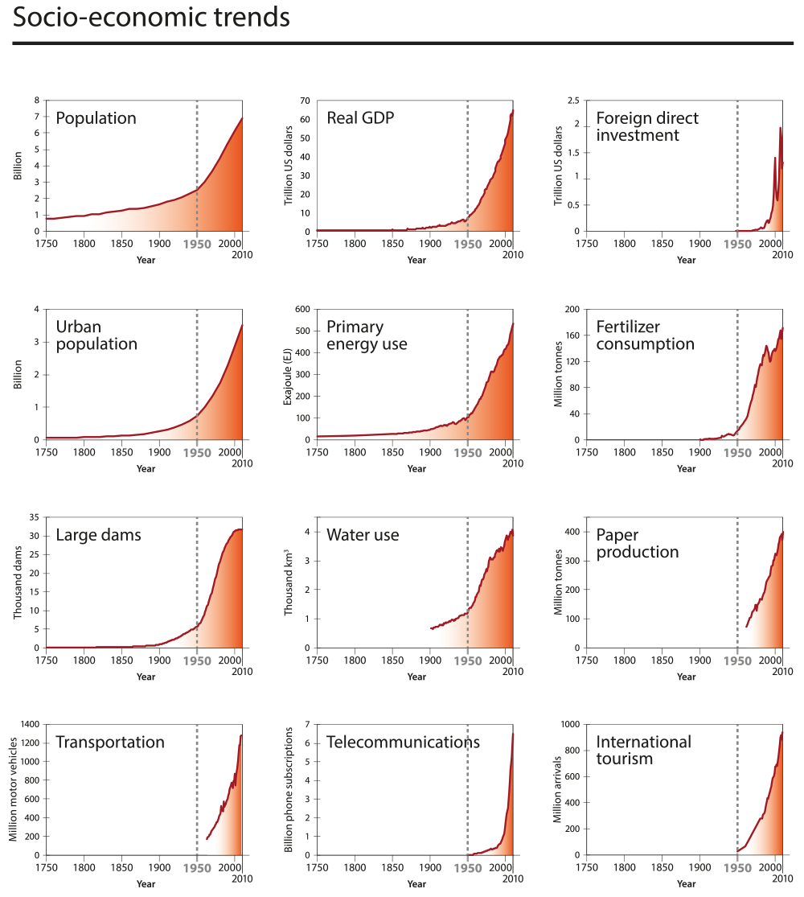
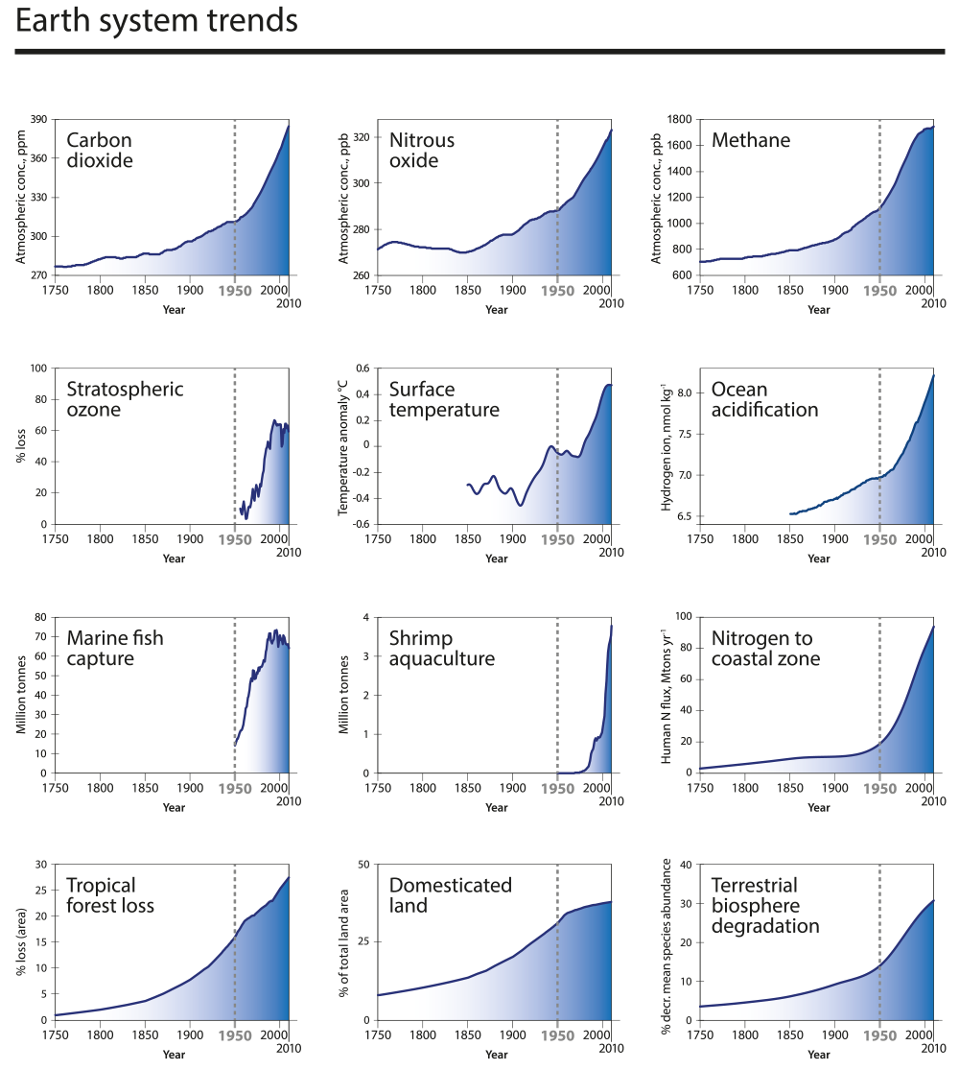
And the “great acceleration”
The parallel between the exponential changes of socio-economics and those of the earth system..
Source : Marc Darras / Jacques MIllery

Slide 13
Individual activity
Within these contexts, please think about what you want to learn here, in this course.
I will make notes and make sure I deal with any points you raise.

Slide 14
Agenda for this S1
Why ?
What ?
How ?
A few initial thoughts and exercices
Work for next time

Slide 15
Course description
Global markets face today more-than-ever challenges that require a blend of specific hard and soft skills.
This module aims to :
expose students with a wide array of real business cases coming from practical experiences in different industries and
ii) provide students with concepts and tools to enable them to understand and set the frameworks of future challenges in daily company tasks as well as in more complex projects leveraging artificial intelligence systems.

Slide 16
A funnel
The course aims to go from "Big to Small": a funnel that moves from General Context, to Business Strategy, Marketing Plans and then specifically focus onto Customer Relationship Management.
General context
Business srategy
Marketing
CRM

Slide 17
Another funnel – we will work on three levels
Business
Operational
Technical

Slide 18
Objectives
LG1 To master artificial intelligence applications for marketing strategy / LO2 To design innovative and disruptive technologies that empower organizations to create, predict and fulfil market demands LG3 To use artificial intelligence for strengthening customer relationships and driving consumer behavior / LO1 To deploy artificial intelligence techniques and tools to improve consumer engagement experiences
Objectif(s) pédagogique(s) The intended learning outcomes of the course are the capabilities to assess the context, put priorities in order, reason critically and think laterally to create unbiased and innovative solutions in different industries. Students should then be able to get inspiration, imagine and build effective and efficient marketing plans to achieve objectives through the application of easy-to-use methodologies.
What do we mean by « reason critically » and « think laterally »?

Slide 19
Critical thinking
There are many very long definitions. My preferred one is short: “The unexamined life is not worth living”. (Socrates)
Question: What are the obstacles to critical thinking in an organisation?

Slide 20
The formula: 14 + 28
Sessions:
February: Wednesdays 1st, 10:00 - 13:00 and 8th 10:00 à 13:00 (6h)
March: Wednesdays 1st, 10:00 - 13:00, 8th, 10:00 - 13:00 and 15th, 10:00 - 12:00 (8h)
Homework : 28 hours i.e. 7 hours between each session.

Slide 21
Bibliography
Porter, E.M. (1998) Competitive Strategy: Techniques for Analyzing Industries and Competitors, Free Press
Grant, M.R (2015) Contemporary Strategy Analysis, John Wiley & Sons
Kartajaya, H., Kotler, P., & Setiawan, I. (2016) Marketing 4.0: Moving from Traditional to Digital, Wiley
Additional references:
International press, including bbc.com theconomist.com | ft.com| theguardian.com | reuters.com | wikipedia.org | piie.com | ec.europa.eu | weforum.org
The large management consulting firms: McKinsey, BCG, Accenture…

Slide 22
Agenda for this S1
Why ?
What ?
How ?
A few initial thoughts and exercices
Work for next time

Slide 23
Practical matters
Values and rules
Communication
Making up the teams
Grading

Slide 24
2 x 3 Values + 3 rules
Academically demanding + Internationalisation + professionnalisation.
The three values of the school: audacity, loyalty and courage.
Three rules:
You communicate with the group, not with any individual students around you.
Be on time.
One student = one screen. Access to PC or mobile, not both.

Slide 25
Communication between us : 3 levels
On a group level, via your representative
On team matters, via the focal points
On individual issues / questions, you can contact me on my mail address.

Slide 26
Team formation
1 team = 3 or 4 students.
I recommend that you do not form teams with people who are too much like yourself. (why?)
Each team has a focal point : this is the team member who will communicate with me and via whom I will be able to communicate with the team.
Please make up these teams right now

Slide 27
Two types of diversity
Identity – sex, nationality, mother tongue, age bracket, skin colour …
Cognitive – having different types of information, knowledge and mental processes.
These two are not entirely disconnected but enable a team to benefit from different experiences and thus enrich their conversation and thinking.
Rule: Good, productive, successful teams are cognitively diverse.

Slide 28
Grading
Continuous evaluation : 40%
Teamwork (written work and presentations).
Individual participation in class. As from session 2, interventions or good questions will be rewarded by 1/10 of a point each time.
Partiel / final exam 60% (format to be confirmed).

Slide 29
Agenda for this S1
Why ?
What ?
How ?
A few initial thoughts and exercices
Work for next time

Slide 30
Roadmap
Three levels of looking at things
The canvas : analysing any business
A few thoughts on strategy

Slide 31
Three levels of looking at things
Macro, the Super-system :
The context
Think, for example, about:
A PC
The Clichy campus
Meso, the System :
The « object of analysis »
Micro – the Sub-systems : a structured examination of the details of the object

Slide 32
Meso / Micro / Macro
Meso - What is the system that is the object of our analysis ?
Micro - What are the details of this system ? We do a « zoom in », we open the meso box and see what’s inside. (This is best done by drawing an arborescence)
Macro - What are the contexts of the system ? We do a « zoom out » to see what the categories are that the system is a part of.

Slide 33
Activity – in teams
Apply this method :
Do a « zoom in » and a « zoom out » for the subject of analysis below:
CRM
15’
PS: you may need to do some internet research

Slide 34
The Canvas
Reference is Strategyzer.com – Alexander Osterwalder
Activities
Channels
The value
proposition
Partnerships
Client
segments
Capabilities
Relationships
Cost structure
Revenue streams

Slide 35
The Canvas : 7 boxes
Value proposition
Channels
Relationships
Clients
Activities
Capabilities
Partnerships

Slide 36
The Value proposition
= three parts
Product characteristics +
Benefits +
« Expérience ».

Slide 37
Activities
= the value chain
The groups of activities that enable a company to propose a product / service.
Q : what is the value chain of a cashmere pullover ?

Slide 38
Capabilities
= What an organisation needs to be able to do in order to create the value proposition.
5 parts:
Knowledge +
Skills +
Design +
Technology / -ies +
Structure.

Slide 39

Activity – in teams
Research freitag.ch/en
Define the value proposition (3 parts)
Define the Capabilities (5 parts) to the extent you know them.
PS: what do you do when you lack information ?

Slide 40
Strategy stuff
Q - are you familiar with:
Macro analysis, for example PESTEL
Sector analysis, for example 5Forces
OGSM *
Research / capabilities analyses, such as SWOT, VRIO * and Benchmarking
The 3 horizons of strategy
KSFs, KPIs

Slide 41
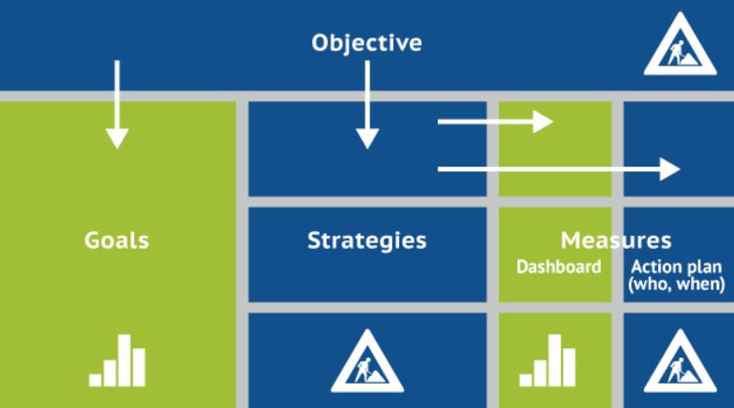
The OGSM method

Slide 42
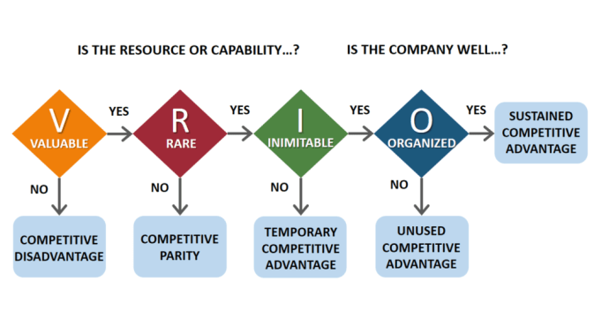

Slide 43
Agenda for this S1
Why ?
What ?
How ?
A few initial thoughts and exercices
Work for next time

Slide 44
Next time, 8th Feb
These first two I will mail on to you
Read, be able to sum up, and formulate questions:
« Generative AI – how will the new era of machine learning affect you? » https://www.ft.com/content/1e34f334-4e73-4677-9713-99f85eed7ba0.
The care of one : hyperpersonalisation of customer care. McKinsey&Co
Download « mckinsey-tech-trends-outlook-2022-full-report.pdf » and read pages 20 – 32 on the subject of Applied AI – and any other pages you feel are of interest to you..

Slide 45

Feedback ?
Your reaction after this first session
“WWW” – What Worked Well
“EBI” – Even Better If

